Slide 1
Secondary Storage Management
Unit - 4

Slide 2
File Systems
File concept
File Attributes
File Operations
File Types
File Structure
Internal File structure
Access methods
Sequential Access
Direct Access
Other Access Methods

Slide 3
Directory Structure
The directory can be viewed as a symbol table that translates file names into their directory entries.
Operations on a directory:
Search for a file
Create a file
Delete a file
List a directory
Rename a file
Traverse the file system

Slide 4
Logical structures of directory
The directory can be organized in many ways.
Following are some schemes for defining logical structure of directories.
Single – Level directory
Two – Level directory
Tree – Structured directory
Acyclic – Graph directories
General Graph directory

Slide 5
Single Level Directory
It is the simplest directory structure
All files are contained in the same directory, which is easy to support and understand.
Limitations are as follows:
When the number of files increases, it becomes difficult to manage
When the system has more than one users, they must have unique names of files.
Even a single user on a single level directory may find it difficult to remember the names of all the files as the number of files increases.

Slide 6
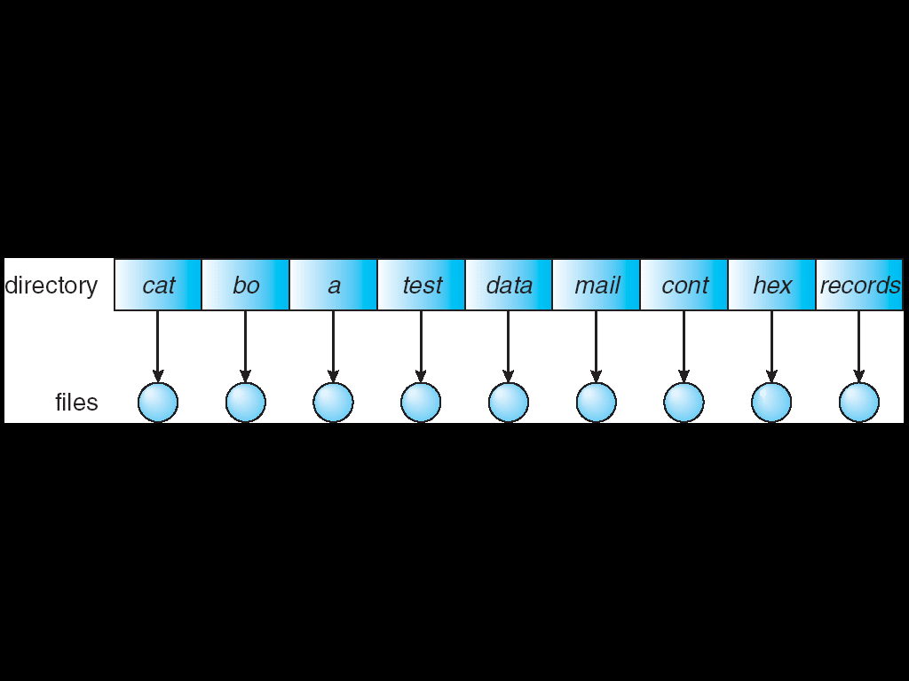
Single Level Directory

Slide 7
Two Level Directory
Separate directory for each user
Each user has his own user file directory (UFD). The UFDs have similar structures, but each lists only the files of a single user.
When a user job starts or a user logs in, the system’s master file directory (MFD) is searched. The MFD is indexed by a user name or account number, and each entry points to the UFD for that user.
When a user refers to a particular file, only his own UFD is searched. Thus, different users may have files with the same name. (within UFD, file name should be unique).
A user name and a file name define a path name. every file in the system has a unique path name.

Slide 8
Two Level Directory
The structure isolates users from other users.
Users cannot access each other’s files, though, they want to share.
Problem occurs with system files. How can we share them?
Duplicate copies will occupy memory space.
A special user directory is defined to contain the system files (i.e. user 0). Whenever a file name is given to be loaded, the os first searches the local UFD. If the file is found, it is used. If not found, the system automatically searches the special user directory that contains system files.
Grouping of files is not possible here.

Slide 9
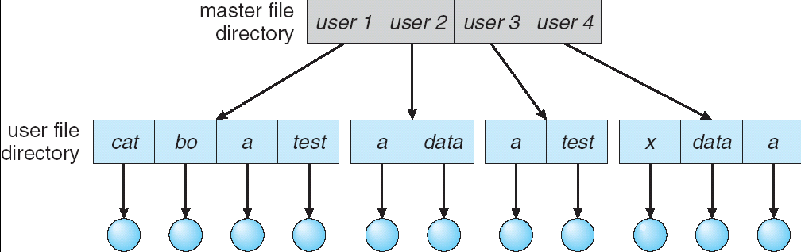
Two Level Directory

Slide 10
Tree Structured Directories
Two level directory is a two-level tree, the tree structured directory is extension to a tree of arbitrary height.
It is the most common directory structure.
The tree has a root directory, and every file in the system has a unique path name.
A directory or subdirectory contains a set of files or subdirectories. A directory is simply another file, but it is treated in a special way.
All directories have the same internal format. One bit in each directory entry defines the entry as a file (o) or as a subdirectory (1).
Special system calls are used to create and delete directories.

Slide 11
In normal use, each process has a current directory. The current directory should contain most of the files that are of current interest to the process. When reference is made to a file, the current directory is searched. If a file is needed that is not in the current directory, then the user usually must either specify a path name or change the current directory to be the directory holding that file.
The user can change his directory whenever he desires.
Path names can be of two types: absolute or relative.
An absolute path name begins at the root and follows a path down to the specified file, giving directory names on the path.
A relative path name defines a path from the current directory.
With this structure, users can be allowed to access, in addition to their files, the files of other users.
Path to a file in a tree structured directory can be longer than a path in a two-level directory.

Slide 12
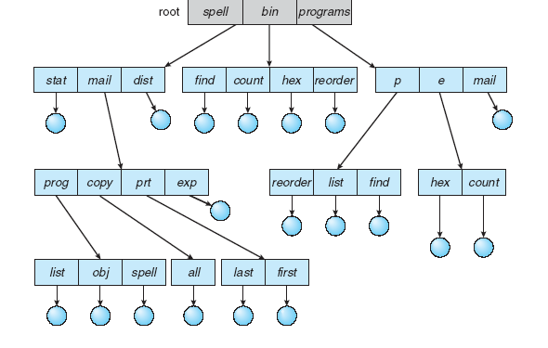
Tree structured directory

Slide 13
Acyclic Graph Directories
A tree structure prohibits the sharing of files or directories.
An acyclic graph that is, a graph with no cycles, allows directories to share subdirectories directories.
Shared file or directory is not the same as two copies of file.
Shared files and subdirectories can be implemented in several ways. By creating a link (which is a pointer) to point same file and secondly duplication of files.
This structure is more flexible than tree structure, but more complex.
This structure has problems like a file may have multiple absolute path names. Consequently, distinct file names may refer to same file.
Second problem is about deletion of files.
Systems like MS-DOS, the directory structure is a tree structure rather than acyclic graph, because it doesn’t allow sharing of files and directories.

Slide 14
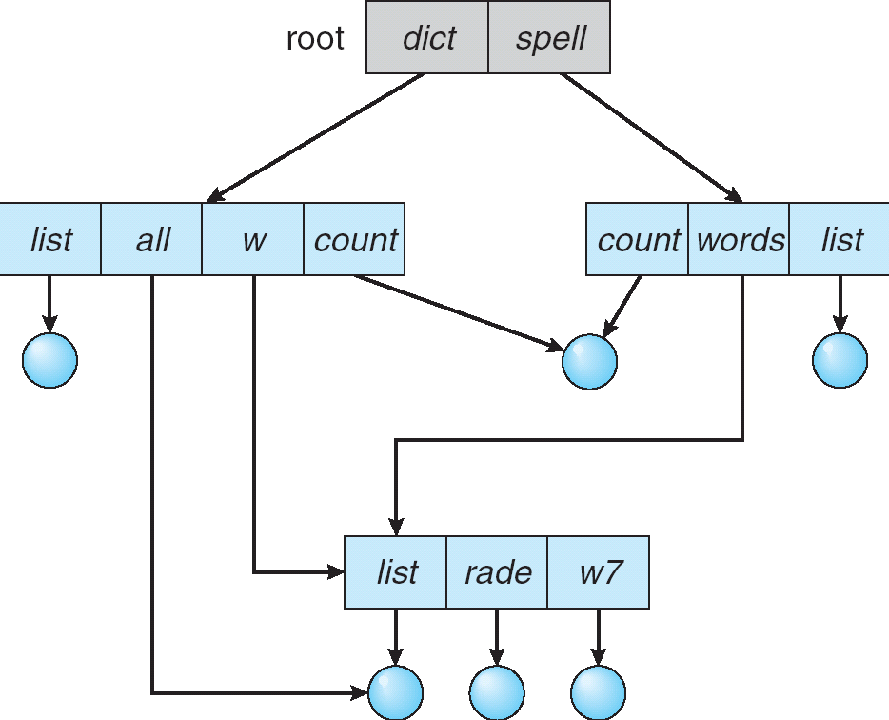
Acyclic Graph Directory

Slide 15
General Graph Directory
The primary advantage of an acyclic graph is the relative simplicity of the algorithms to traverse the graph and to determine when there are no more references to a file.
If cycles are allowed to exist in the directory, we likewise want to avoid searching any component twice.
A poorly designed algorithm might result in an infinite loop.

Slide 16
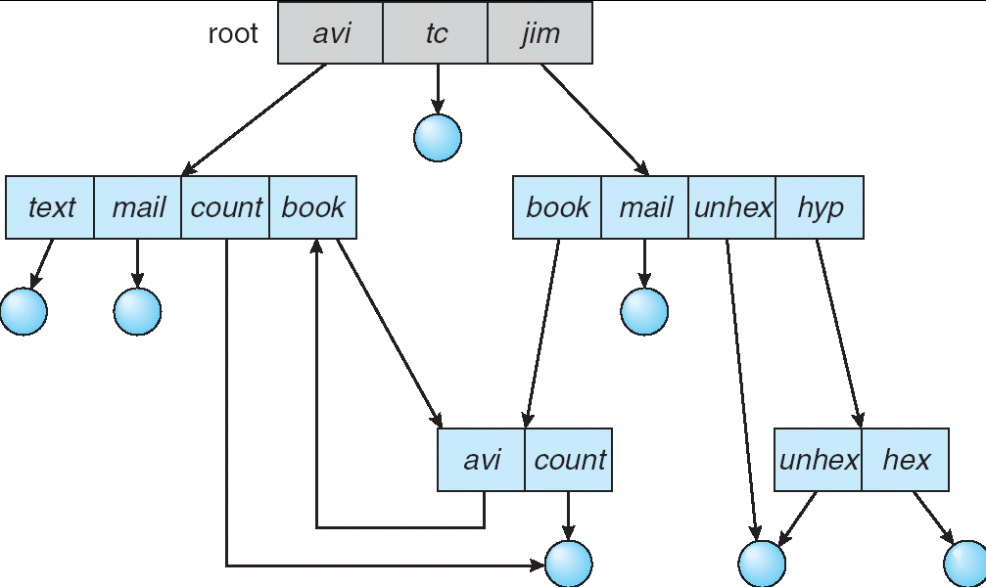
General Graph Directory

Slide 17
Directory Structure
Directory overview
Single – Level directory
Two – Level directory
Tree – Structured directory
Acyclic – Graph directories
General Graph directory
File – System Mounting

Slide 18
Secondary Storage Structure
Overview of Mass – Storage Structure
Magnetic Disks
Magnetic Tapes
Disk Structure
Disk Attachment
Host – Attached Storage
Network – Attached Storage
Storage – Area Network

Slide 19
Disk Scheduling
Seek time: The time for disk arm to move the heads to the cylinder containing the desired sector.
Rotational latency: The additional time for the disk to rotate the desired sector to the disk head.
Disk Bandwidth: The total number of bytes transferred, divided by the total time between the first request for service and the completion of the last transfer.

Slide 20
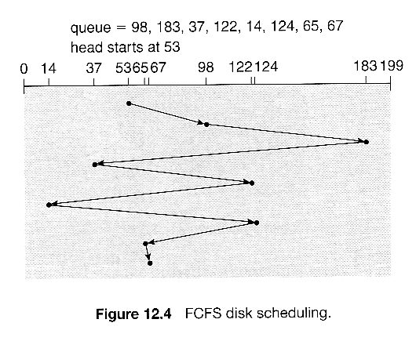
FCFS
Disk Scheduling Algorithms

Slide 21
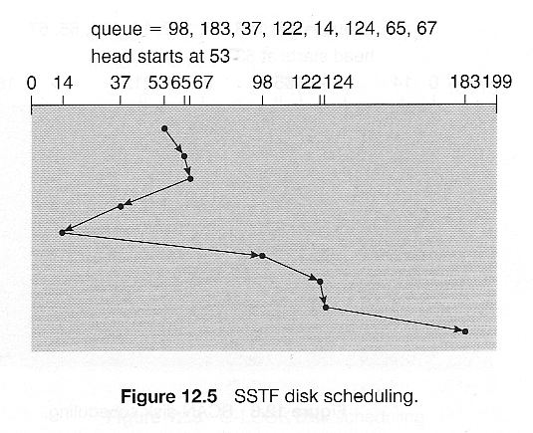
SSTF
Disk Scheduling Algorithms

Slide 22
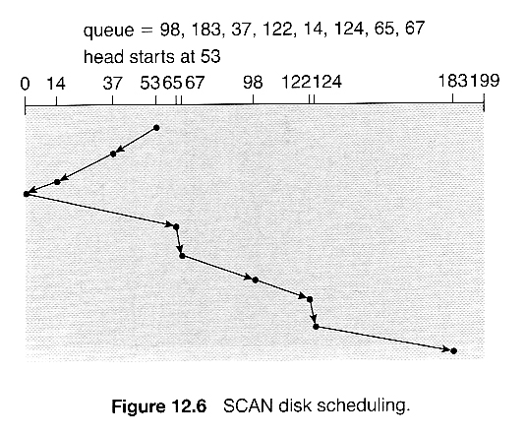
SCAN (Elevator Algorithm)
Disk Scheduling Algorithms

Slide 23
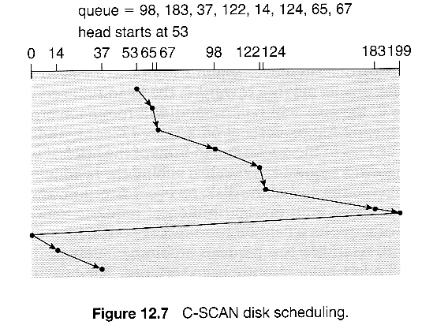
C - SCAN
Disk Scheduling Algorithms

Slide 24
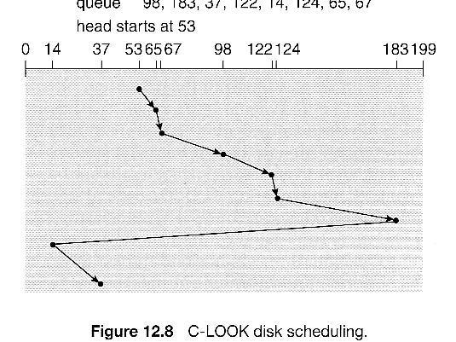
LOOK
Disk Scheduling Algorithms

Slide 25
Selection of a Disk-Scheduling Algorithm
With very low loads all algorithms are equal, since there will normally only one request to be processed at a time.
For slightly larger loads, SSTF offers better performance than FCFS, but may lead to starvation when loads become heavy enough.
For busier systems, SCAN and LOOK algorithms eliminate starvation problems.
Request for disk service can be influenced by the file allocation method. (Contiguous v/s linked or indexed file)
The location of directories and indexed blocks is also important. (Distance between directory entry and file’s data)

Slide 26
Selection of a Disk-Scheduling Algorithm
Because of these complexities, the disk scheduling algorithm should be written as a separate module of the operating system, so that it can be replaced with a different algorithm if necessary. (Any one algorithm would be default algo. In that case)
On modern disks the rotational latency can be almost as significant as the seek time, however it is not within the OSes control to account for that, because modern disks do not reveal their internal sector mapping schemes, some disk manufacturers provide for disk scheduling algorithms directly on their disk controllers, ( which do know the actual geometry of the disk), so that if a series of requests are sent from the computer to the controller then those requests can be processed in an optimal order.
Unfortunately there are some considerations that the OS must take into account that are beyond the abilities of the on-board disk-scheduling algorithms, such as priorities of some requests over others, or the need to process certain requests in a particular order. For this reason OS may elect to spoon-feed requests to the disk controller one at a time in certain situations (Like system crash).

Slide 27
RAID Structures
The general idea behind RAID (Redundant Array of Inexpensive / Independent Disks) is to employ a group of hard drives together with some form of duplication, either to increase reliability or to speed up operations, or sometimes both.
Disk drives have continued to get smaller and cheaper, so it is now economically feasible to attach many disks to a computer system.
"RAID" is now used as an umbrella term for computer data storage schemes that can divide and replicate data among multiple hard disk drives.

Slide 28
Improvement of reliability via Redundancy
The more disks a system has, the greater the likelihood that one of them will go bad at any given time. Hence increasing disks on a system actually decreases the Mean Time To Failure, MTTF of the system.
If, however, the same data was copied onto multiple disks, then the data would not be lost unless all copies of the data were damaged simultaneously, which is a much lower probability than for a single disk going bad. More specifically, the second disk would have to go bad before the first disk was repaired, which brings the Mean Time To Repair into play.
This is the basic idea behind disk mirroring, in which a system contains identical data on two or more disks.
Note that a power failure during a write operation could cause both disks to contain corrupt data, if both disks were writing simultaneously at the time of the power failure.

Slide 29
Improvement of reliability via Redundancy
One solution is to write to the two disks in series, so that they will not both become corrupted (at least not in the same way) by a power failure. And alternate solution involves non-volatile RAM as a write cache, which is not lost in the event of a power failure and which is protected by error-correcting codes.
Redundancy can also achieved by collecting data (known as parity data) across the array, calculated such that the failure of one (or possibly more, depending on the type of RAID) disks in the array will not result in loss of data.
A failed disk may be replaced by a new one, and the lost data reconstructed from the remaining data and the parity data.

Slide 30
Data recovery using Parity Bits
Parity data in a RAID environment is calculated using the Boolean XOR function.
For example, here is a simple RAID 4 three-disk setup consisting of two drives that hold 8 bits of data each and a third drive that will be used to hold parity data.
Drive 1: 01101101
Drive 2: 11010100
To calculate parity data for the two drives, an XOR is performed on their data.
i.e. 01101101 XOR 11010100 = 10111001
The resulting parity data, 10111001, is then stored on Drive 3, the dedicated parity drive.

Slide 31
Data recovery using Parity Bits
Should any of the three drives fail, the contents of the failed drive can be reconstructed on a replacement (or "hot spare") drive by subjecting the data from the remaining drives to the same XOR operation.
If Drive 2 were to fail, its data could be rebuilt using the XOR results of the contents of the two remaining drives, Drive 3 and Drive 1:
Drive 3: 10111001
Drive 1: 01101101
i.e. 10111001 XOR 01101101 = 11010100
This same XOR concept applies similarly to larger arrays, using any number of disks.

Slide 32
Improvement in Performance via Parallelism
There is also a performance benefit to mirroring, particularly with respect to reads. Since every block of data is duplicated on multiple disks, read operations can be satisfied from any available copy, and multiple disks can be reading different data blocks simultaneously in parallel.
Writes could possibly be speeded up as well through careful scheduling algorithms, but it would be complicated in practice.
Another way of improving disk access time is with striping, which basically means spreading data out across multiple disks that can be accessed simultaneously.

Slide 33
Improvement in Performance via Parallelism
With bit-level striping the bits of each byte are striped across multiple disks. For example if 8 disks were involved, then each 8-bit byte would be read in parallel by 8 heads on separate disks.
Block-level striping spreads a file system across multiple disks on a block-by-block basis, so if block N were located on disk 0, then block N + 1 would be on disk 1, and so on. This is particularly useful when file systems are accessed in clusters of physical blocks.
Other levels of striping, such as bytes of a sector or sectors of a block, also are possible.
Parallelism in a disk system has two main goals:
Increase the throughput of multiple small accesses by load balancing.
Reduce the response time of large accesses.

Slide 34
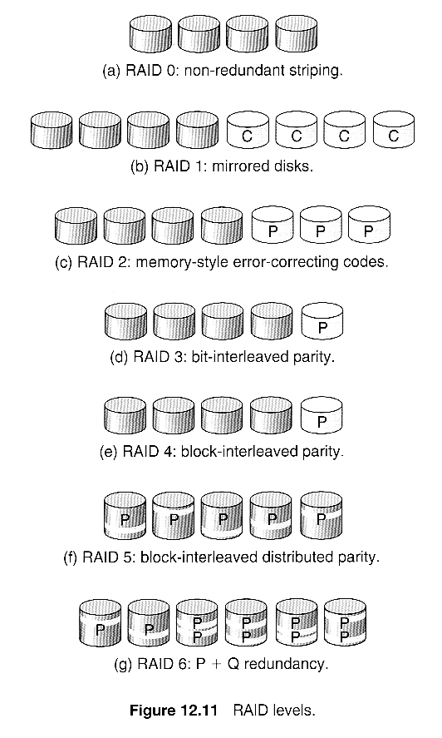
RAID Levels

Slide 35
RAID Levels
RAID level 0: It refers to disk arrays with striping at the level of blocks but without any redundancy. The only purpose is speed. If one disk fails, however, all of the data on the array will be lost, as there is neither parity nor mirroring. It requires a minimum of two drives.
RAID level 1: It refers to disk mirroring only, not striping. It mirrors the contents of the disks, making a form of 1:1 ratio real-time backup. The contents of each disk in the array are identical to that of every other disk in the array. It requires a minimum of two drives.
RAID level 2: This level stores error-correcting codes on additional disks, allowing for any damaged data to be reconstructed by subtraction from the remaining undamaged data. Note that this scheme requires only three extra disks to protect 4 disks worth of data, as opposed to full mirroring.

Slide 36
RAID Levels
RAID level 3: Also known as bit-interleaved parity organization. It improves on level 2 by taking into account the fact that, unlike memory systems, disk controllers can detect whether a sector has been read correctly, so a single parity bit can be used for error correction as well as for detection.
RAID level 3 has two advantages over level 1. First, the storage overhead is reduced as only one parity disk is needed for several regular disks. Second, since reads and writes of a byte are spread out over multiple disks with N-way striping of data, the transfer rate for reading or writing a single block is N times as fast as with RAID level 1.
Disadvantage is that, it supports fewer I/O per second, since every disk has to participate in every I/O request. Another disadvantage is the expense of computing and writing the parity, which slows writes than non parity RAID arrays.
To overcome second problem, many RAID storage arrays include a hardware controller with dedicated parity hardware.

Slide 37
RAID Levels
RAID level 4: Also known as block-interleaved parity organization. Uses block-level striping, as in RAID 0, and in addition keeps a parity block on a separate disk for corresponding blocks from N other disks.
If one of the disks fails, the parity block can be used with the corresponding blocks from the other disks to restore the blocks of the failed disk.
A block read accesses only one disk, allowing other requests to be processed by the other disks. Thus, the data transfer rate for each access is slower, but multiple read accesses can proceed in parallel, leading to a higher overall I/O rate.
The benefits are that multiple blocks can be read independently, and changes to a block only require writing two blocks ( data and parity ) rather than involving all disks.
Note that new disks can be added seamlessly to the system provided they are initialized to all zeros, as this does not affect the parity results.

Slide 38
RAID Levels
RAID level 5 : Also known as block interleaved distributed parity. This level is similar to level 4, except the parity blocks are distributed over all disks, thereby more evenly balancing the load on the system.
For any given block on the disk(s), one of the disks will hold the parity information for that block and the other N-1 disks will hold the data.
Note that the same disk cannot hold both data and parity for the same block, as both would be lost in the event of a disk crash.
RAID level 6: Also called the P + Q redundancy scheme, is much like RAID level 5 but stores extra redundant information to guard against multiple disk failures.
Instead of parity, error correcting codes such as the Reed – Solomon codes are used. In this scheme, 2 bits of redundant data are stored for every 4 bits of data ( 1 parity bit in level 5) and the system can tolerate two disk failures.

Slide 39
RAID Levels
RAID levels 0 + 1 and 1 + 0 : RAID 0 provides performance, while RAID 1 provides the reliability.
In RAID 0 + 1, a set of disks are striped, and then the stripe is mirrored to another, equivalent stripe.
In RAID 1 + 0, disks are mirrored in pairs and then the resulting mirrored pairs are striped. If a single disk fails in RAID 0 + 1, an entire stripe is inaccessible, leaving only the other stripe available. With the failure in second one, a single disk is unavailable, but the disk that mirrors it is still available, as are all the rest of the disks.
Generally this level provides better performance than RAID 5.
It is common in environments where both performance and reliability are important.
It doubles the number of disks needed for storage, so its expensive.

Slide 40
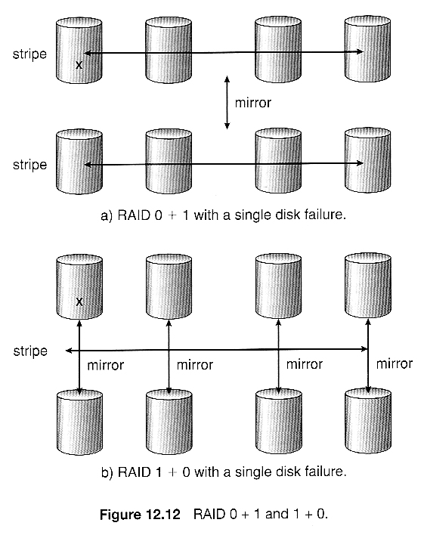
RAID levels 0 + 1 and 1 + 0

Slide 41
Selecting RAID levels
Trade-offs in selecting the optimal RAID level for a particular application include cost, volume of data, need for reliability, need for performance, and rebuild time, the latter of which can affect the likelihood that a second disk will fail while the first failed disk is being rebuilt.
Other decisions include how many disks are involved in a RAID set and how many disks to protect with a single parity bit.
More disks in the set increases performance but increases cost.
Protecting more disks per parity bit saves cost, but increases the likelihood that a second disk will fail before the first bad disk is repaired.

Slide 42
Extensions
RAID concepts have been extended to tape drives ( e.g. striping tapes for faster backups or parity checking tapes for reliability ), and for broadcasting of data.

Slide 43
Problems with RAID
RAID protects against physical errors, but not against any number of bugs or other errors that could write erroneous data.
Another problem with traditional file systems is that the sizes are fixed, and relatively difficult to change. Where RAID sets are involved it becomes even harder to adjust file system sizes, because a file system cannot span across multiple filesy stems.

